Slide 1
CS 6476 Project 4
Name: Shen-Yi Cheng
GT email: scheng98@gatech.edu
GTID: 903514405

Slide 2
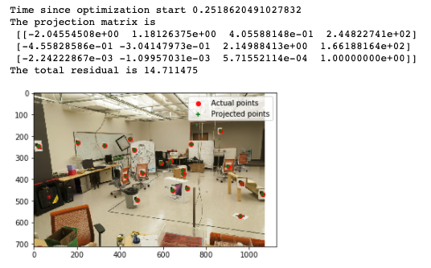
Part 1: Projection Matrix
<insert visualization of projected 3D points and actual 2D points for image provided by us and the total residual here>

Slide 3
Part 1: Projection Matrix
At least how many 3D-2D point correspondences do you need to estimate the projection matrix? Why?
At least 8 points for projection matrix. Because the least_square solution needs 8 points to do estimation.

Slide 4
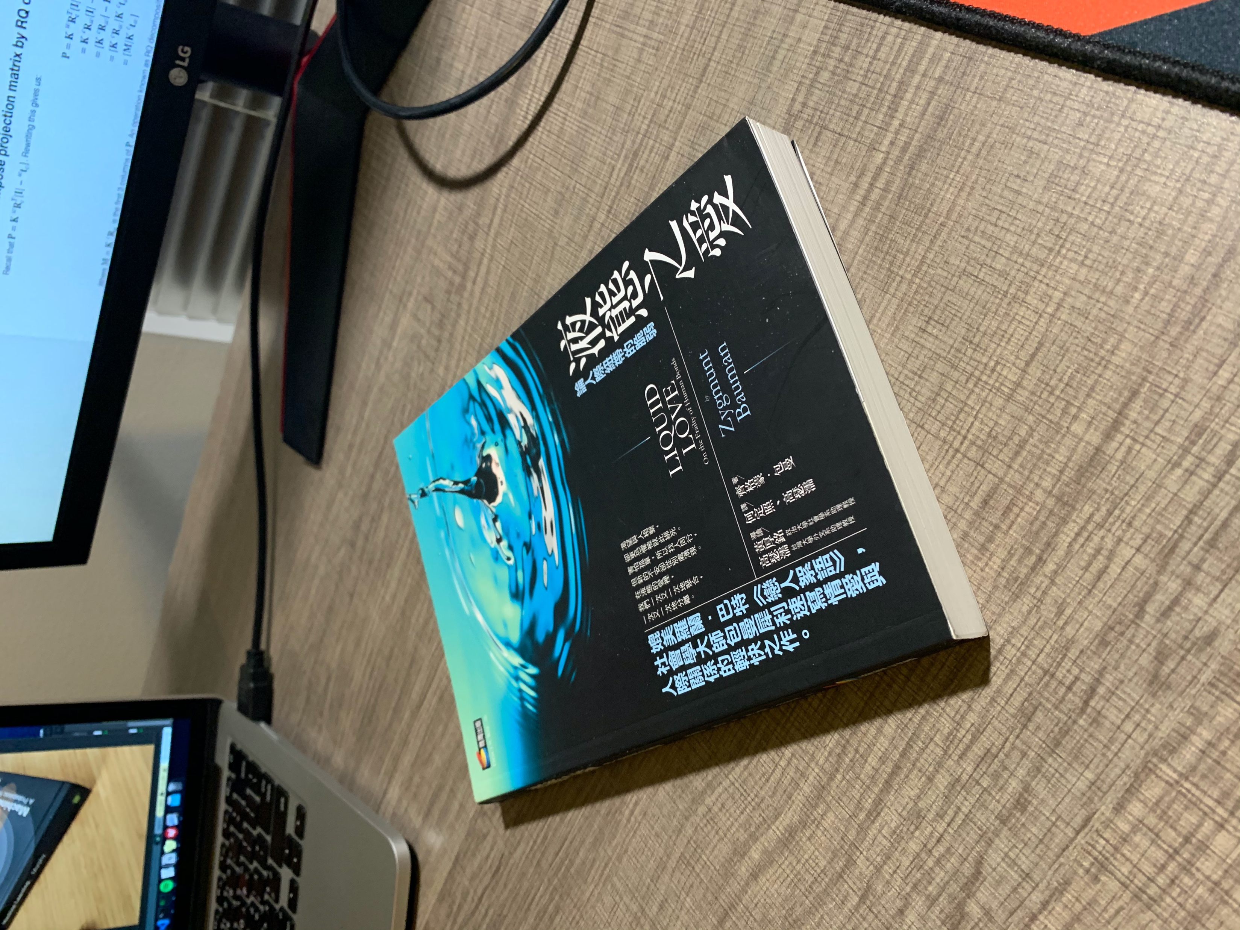
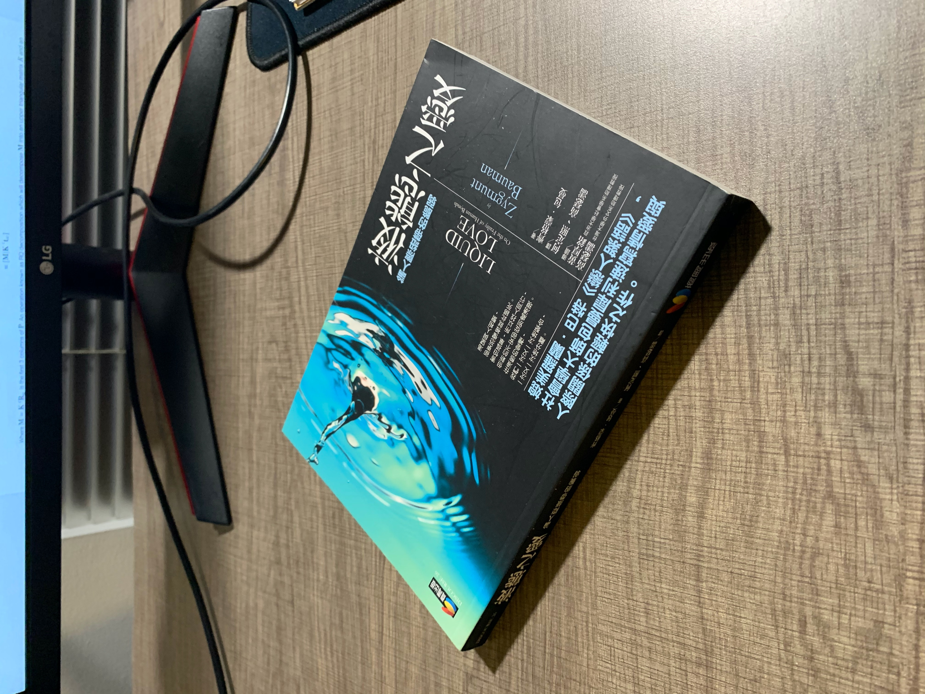
Part 2: Estimation with Your Own Images
< insert the two images of your fiducial object here>

Slide 5
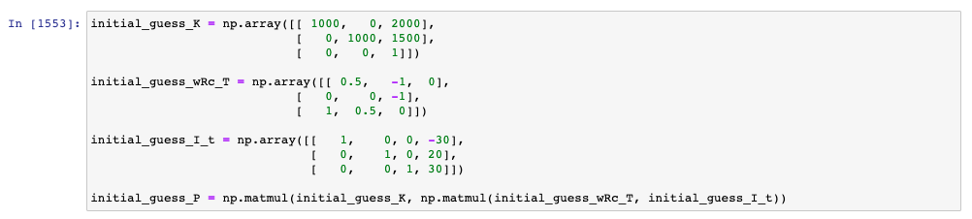
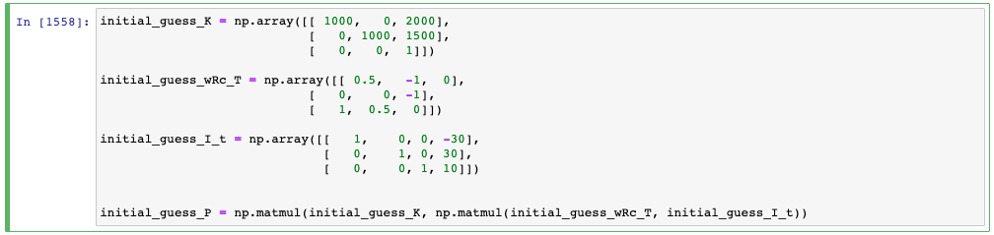
Part 2: Estimation with Your Own Images
<insert visualization the initial guesses for rotation matrix and camera center for the two images you took here>

Slide 6
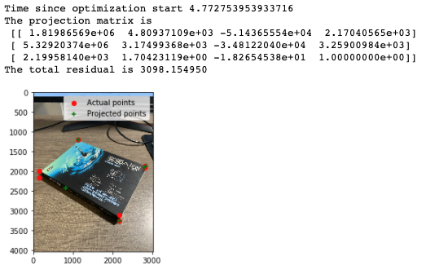
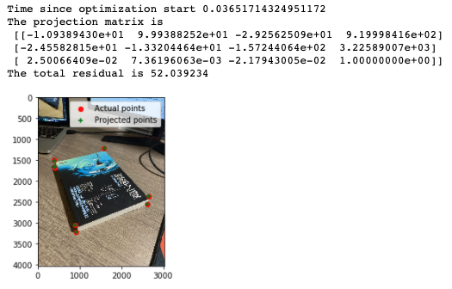
Part 2: Estimation with Your Own Images
<insert visualization of projected 3D points and actual 2D points for both the images you took>

Slide 7
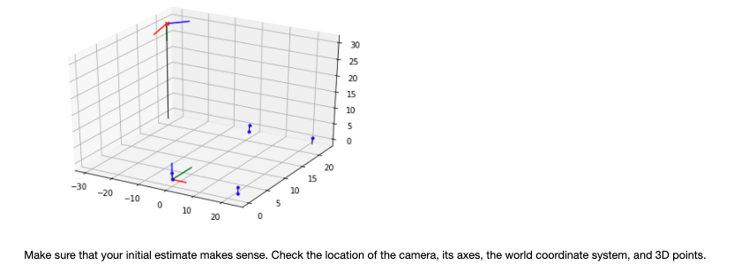
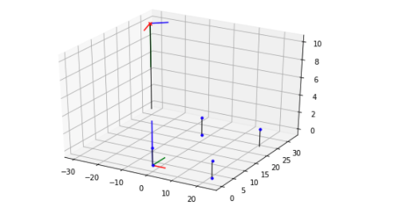
Part 2: Estimation with Your Own Images
<insert visualization of both camera poses of images you took here>

Slide 8
Part 2: Estimation with Your Own Images
What would happen to the projected points if you increased/decreased the x coordinate, or the other coordinates of the camera center t? Write down a description of your expectations in the appropriate part of your writeup submission.
The estimation will be shift if we increased/decreased the coordinate of the camera center. Changing x would shift up and down. Changing y would ship right and left.
Perform this shift for each of the camera coordinates and then recompose the projection matrix and visualize the result in the Jupyter notebook. Was the visualized result what you expected?
Yes, the projection dots do shift followed by the changing of x or y.xw

Slide 9
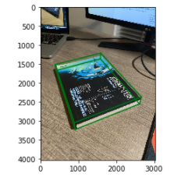
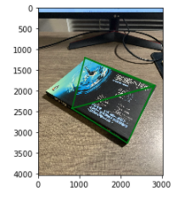
Part 2: Estimation with Your Own Images
<insert both images you take with bounding boxes around your fiducial object>

Slide 10
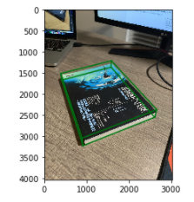
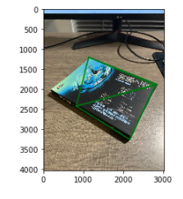
Part 3: Camera Coordinates
<insert both images you take with bounding boxes around your fiducial object>

Slide 11
Part 3: Camera Coordinates
The first three rows of the transformation matrix are just the extrinsic parameters of our camera, why is that?
Because the first three rows are directly from the wtc matrix.
Wtc matrix is the coordinate of the camera
Say if we know the coordinates of 3D points in camera 1 coordinate system, and we want to transform them into camera 2 coordinate system, what should we do? You may assume that the poses of both cameras are known.
We can use the projection matrix of camera 1 to get the world coordinate of the 3D points and use the projection matrix of camera 2 to transform into camera 2 coordinate system

Slide 12
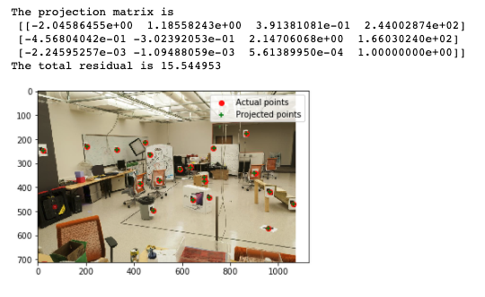
Part 4: DLT
<insert visualization of projected 3D points and actual 2D points for image provided by us and the total residual here>

Slide 13
Part 4: DLT
Why do we need the cross product trick?
The homogeneous linear equation is:
0 = [x_k] x A * y_k
[x_k] is the matrix representation of the vector cross product
We pick up the eigenvector with the smallest eigenvalue. Will this eigenvalue be exactly zero? Why/why not?
The smallest eigenvalue would not be exactly zero in every circumstance. It based on the singular value decomposition result. However , each column of V represents a solution of Ah = 0. Moreover, SVD does not deal well with outliers.

Slide 14
EC: RANSAC Iterations Questions
How many RANSAC iterations would we need to find the fundamental matrix with 99.9% certainty from your Mount Rushmore and Notre Dame SIFTNet results assuming that they had a 90% point correspondence accuracy?
Iteration: 15
One might imagine that if we had more than 9 point correspondences, it would be better to use more of them to solve for the fundamental matrix. Investigate this by finding the number of RANSAC iterations you would need to run with 18 points.
Iteration: 43
If our dataset had a lower point correspondence accuracy, say 70%, what is the minimum number of iterations needed to find the fundamental matrix with 99.9% certainty?
Iteration: 168

Slide 15
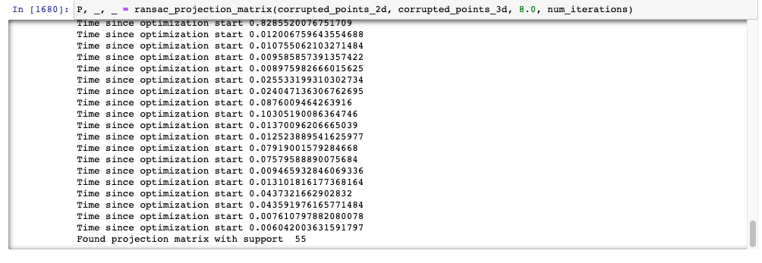
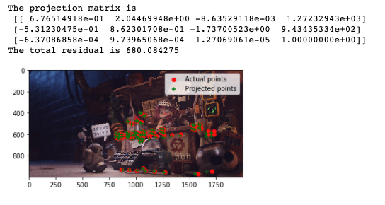
EC: RANSAC
<insert the number of inliers from your best model here>
55
<insert the image and total residual here>

Slide 16
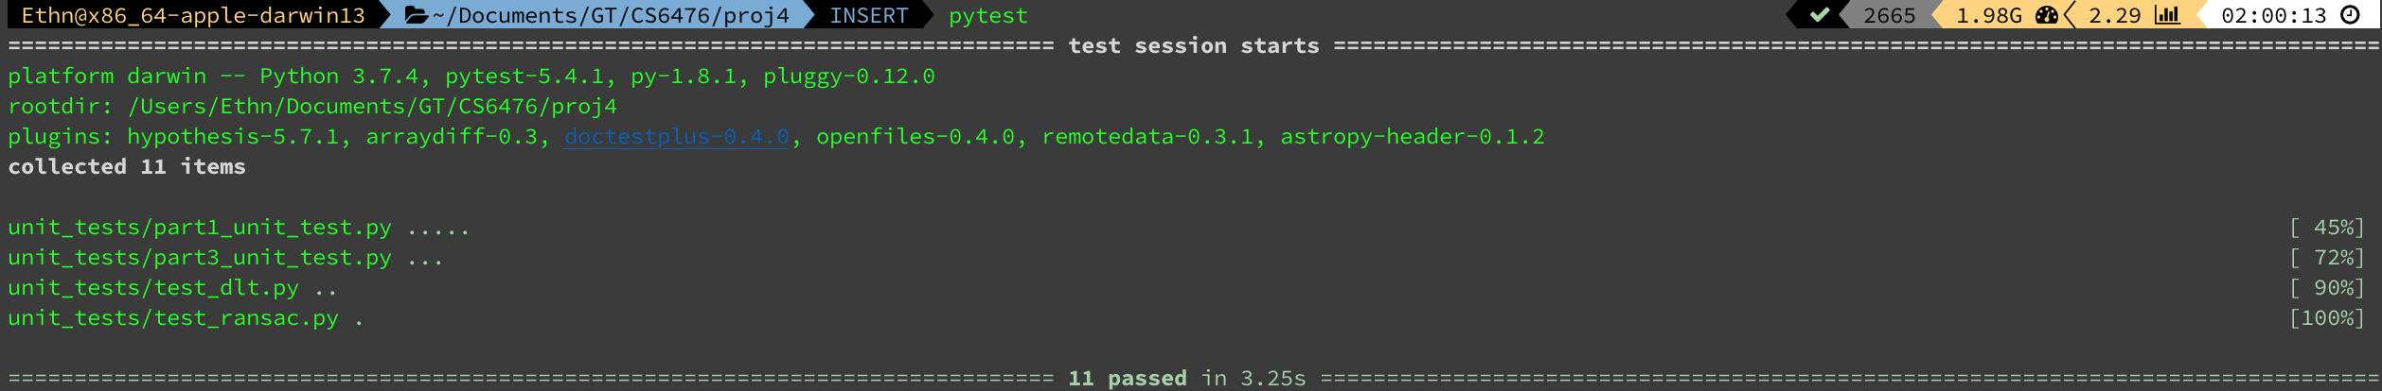
Tests
<Provide a screenshot of the results when you run `pytest` from the unit tests directory with your final code implementation (note: we will re-run these tests).>

Slide 17
Conclusions
<Describe what you have learned in this project. Feel free to include any challenges you ran into.>
It is difficult to find a perfect initial estimation
To many algebra in this project. I spend a lot of time to read and understand the concept.

